Slide 1
Artificial Intelligence Introduction to Logic
unknown
RL
known
deterministic
stochastic
atomic
SEARCH
MDPs
factored
LOGIC
Bayes nets
structured
First-order logic

Slide 2
Outline
Knowledge
Data to Intelligence
Knowledge Base
Knowledge Base Agent
Knowledge Representation
Logical
Semantic Net
Frames
Production Rules

Slide 3
Knowledge
The fact or condition of knowing something with familiarity gained through experience or association.
Knowing something via seeing, hearing, touching, feeling, and tasting .
Acquaintance with or understanding of a science, art, or technique
The fact or condition of being aware of something
The range of one's information or understanding
The fact or condition of having information or of being learned
The sum of what is known : the body of truth, information, and principles acquired by mankind

Slide 4
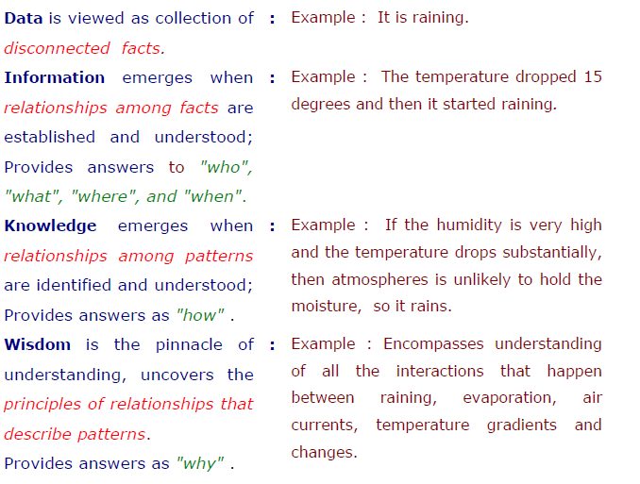
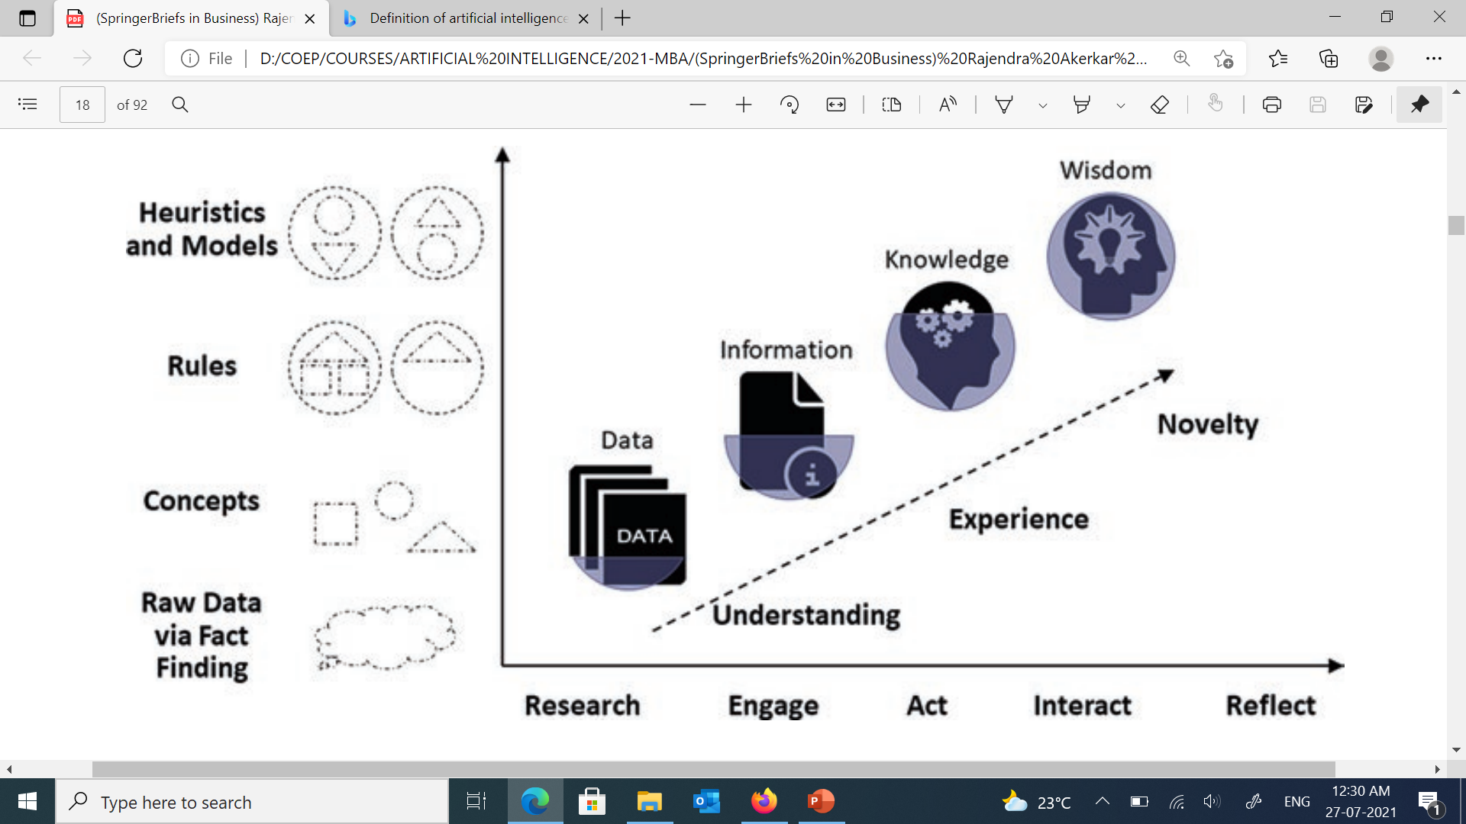
Convergence from Data to Intelligence

Slide 5





Types of Knowledge
Declarative
It includes concepts, facts, and objects and expressed in a declarative sentence.
Heuristic
01
This represents some expert knowledge in the field or subject.
05
02
Structural
It is a basic problem-solving knowledge that describes the relationship between concepts and objects.
.
Meta-Knowledge
04
03
Meta Knowledge defines knowledge about other types of Knowledge.
.
Procedural
This is responsible for knowing how to do something and includes rules, strategies, procedures, etc.
Notes:
© Copyright PresentationGO.com – The free PowerPoint and Google Slides template library
<number>

Slide 6




Different Kinds of Knowledge
Fact
Object
Knowledge of the factual description of the world
Information regarding these objects is something that consider as a type of knowledge. cars have wheels, and the piano has keys, the train is a locomotive
01
06
02
Meta-Knowledge
Event
Knowledge about What we know, What we know that we don’t know
.
What we know regarding the various events that have taken place in our world. The wars, famines, achievements, advancement of societies, etc.
05
03
04
Knowledge Base
Performance
Knowledge Base collection of factual sentences about the area of interest
How humans and other beings and things perform certain actions in different situations. Helps in understanding the behavior side of the knowledge.
Notes:
© Copyright PresentationGO.com – The free PowerPoint and Google Slides template library
<number>

Slide 7
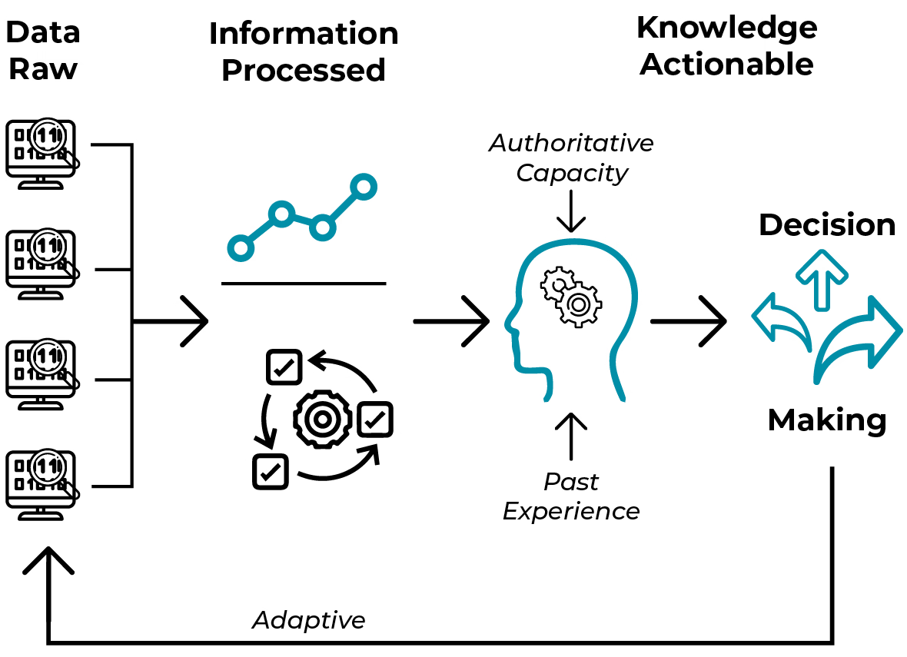
From Data to Knowledge

Slide 8
Knowledge Base
Knowledge base = set of sentences in a formal language
Declarative approach to building an agent (or other system):
Tell it what it needs to know (or have it Learn the knowledge)
Then it can Ask itself what to do—answers should follow from the KB
For Example:
Tell: Father of Dipak is Ramesh
Tell: Jyoti is Dipak sister
Tell: Dipak father is the same as Jyoti sister father
Ask

Slide 9
Knowledge, contd.
Knowledge base = set of sentences in a formal language
Declarative approach to building an agent (or other system):
Tell it what it needs to know (or have it Learn the knowledge)
Then it can Ask itself what to do—answers should follow from the KB
Agents can be viewed at the knowledge level i.e., what they know, regardless of how implemented
A single inference algorithm can answer any answerable question
Domain-specific facts
Knowledge base
Inference engine
Generic code

Slide 10
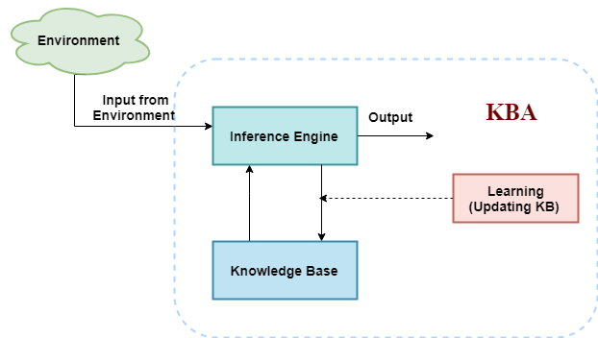
Knowledge Base Agent in AI
An intelligent agent needs knowledge about the real world for taking decisions and reasoning to act efficiently.
Knowledge-based agents are those agents who have the capability of
Maintaining an internal state of knowledge
Reason over that knowledge
Update their knowledge after observations
Take actions.
These agents can represent the world with some formal representation and act intelligently.

Slide 11
Knowledge Base Agent in AI
Knowledge-base:
It is a collection of sentences, expressed in a language which is called a knowledge representation language.
The Knowledge-base of KBA stores fact about the world.
Inference Engine:
Deriving new sentences from old.
Allows us to add a new sentence to the knowledge base.
Inference system applies logical rules to the KB to deduce new information.
Inference system generates new facts so that an agent can update the KB.

Slide 12
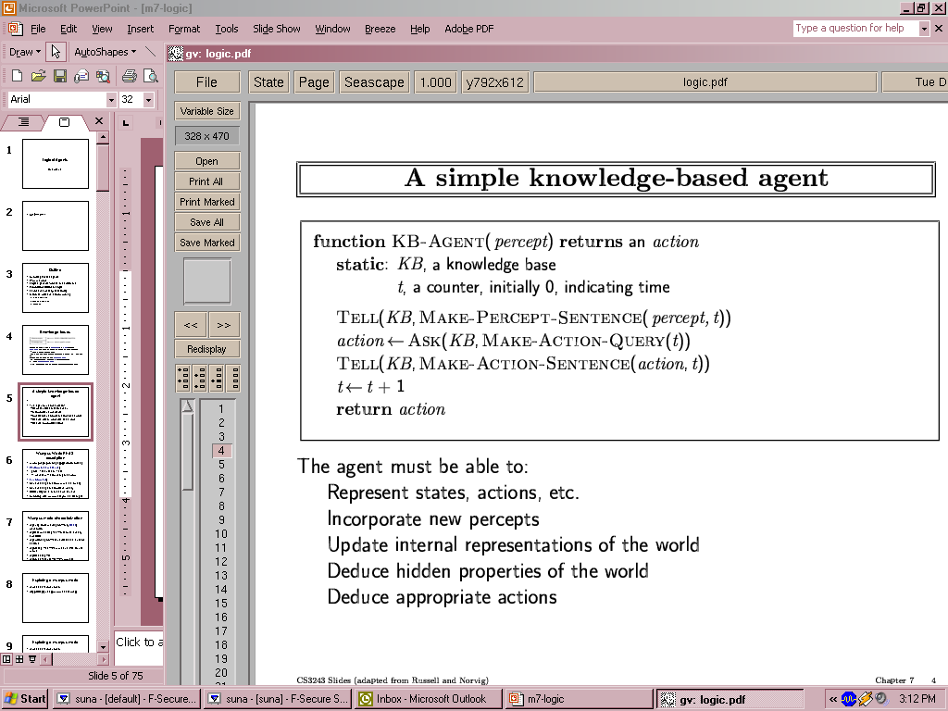
A simple knowledge-based agent
The agent must be able to:
Represent states, actions, etc.
Incorporate new percepts
Update internal representations of the world
Deduce hidden properties of the world
Deduce appropriate actions
Notes:
<number>

Slide 13
A simple knowledge-based agent
Asserting agent perceived the given percept at the given time
Asks what action should be done at the current time
Asserting that the chosen action was executed
Agent program
TELLs the knowledge base what it perceives.
ASKs the knowledge base what action it should perform
TELL
Declarative Approach:
TELLing what need to know
TELL sentence one by one until agent know how to operate in environment
Notes:
<number>

Slide 14
Approaches to Designing a Knowledge-Based Agent
Procedural
Algorithms + Data Structures
= Programs
Declarative
Knowledge Base + Inference
= Expert System
Knowledge about “how to do something”
Focuses on task that must be performed to reach a goal
E.g. Procedure, functions, rules,
Knowledge about “that something is true or false”
Representation of objects and events: knowledge about facts and relationships
E.g. concept, facts, proposition, assertions, logic, semantics nets

Slide 15
Cycle of Knowledge Representation in AI
Learns from the captured data. Build computers that can be taught instead of
programming them. Learning focuses
on the process of self-improvement.
Learning
Retrieves data from the environment
Perception
Perception
Knowledge Representation
Knowledge Representation
Reasoning
Decision making
Understand and build
intelligent behavior.
Focus on what an agent needs to know in order to behave intelligently
Planning
Giving an initial state, finding their preconditions and effects, and a sequence of actions to achieve a state in which a particular goal holds.
Final stage is the execution of the entire process.
Execution

Slide 16
Knowledge Representation in AI

Slide 17





Techniques of Knowledge Representation
Production Rules
Logical
Conditions and Relative Actions
Propositional Logic
First Order Logic
01
04
02
03
Frames
Semantic Network
Record like structure which consists of a collection of attributes and its values
Graphical Representation
Notes:
© Copyright PresentationGO.com – The free PowerPoint and Google Slides template library
<number>

Slide 18
Different kinds of logic
Propositional logic
Syntax: P ∨ (¬Q ∧ R); X₁ ⇔ (Raining ⇒ ¬Sunny)
Possible world: {P=true,Q=true,R=false,S=true} or 1101
Semantics: α ∧ β is true in a world iff is α true and β is true (etc.)
First-order logic
Syntax: ∀x ∃y P(x,y) ∧ ¬Q(Joe,f(x)) ⇒ f(x)=f(y)
Possible world: Objects o₁, o₂, o₃; P holds for <o₁,o₂>; Q holds for <o₃>; f(o₁)=o₁; Joe=o₃; etc.
Semantics: φ(σ) is true in a world if σ=o_{j} and φ holds for o_{j}

Slide 19
Logical Representation

Slide 20
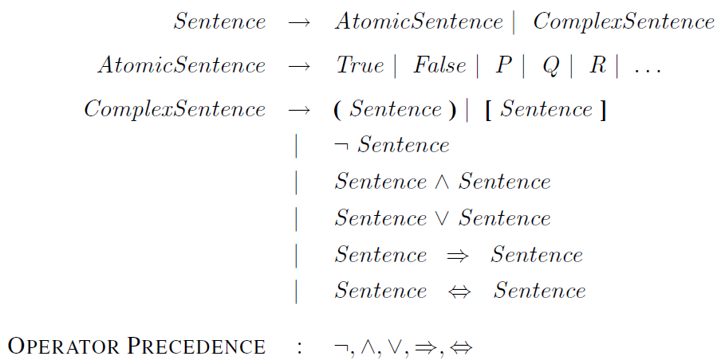
Propositional logic
We have the following sentences:
P: “Humidity is high”
Q: “Temperature is high”
C: “One feels comfortable”.
Then the sentence “If the humidity is high and the temperature is high, then one does not feel comfortable” represented by:
((P∧Q)⇒(~C))
Notes:
<number>

Slide 21
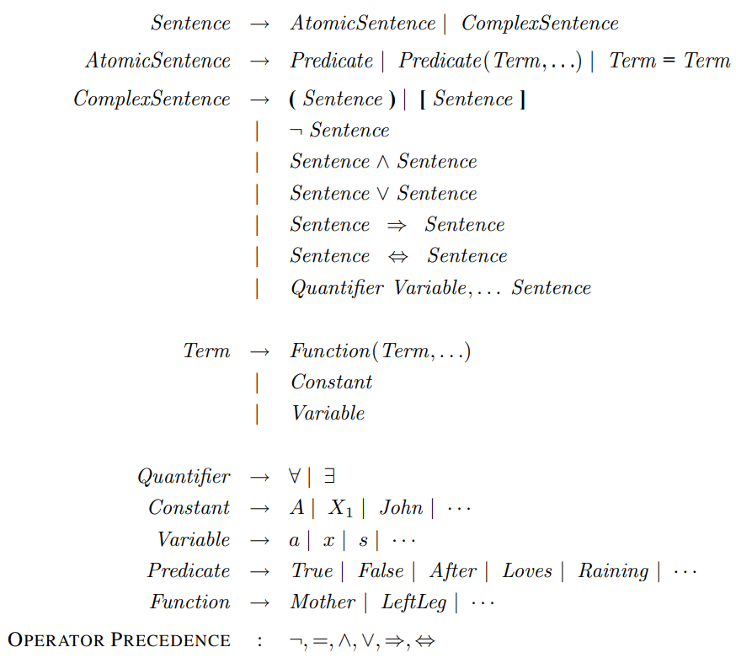
First Order Logic
All birds fly.
The predicate is "fly(bird).“
∀x bird(x) →fly(x)
Every man respects his parent.
The predicate is "respect(x, y),"
where x=man, and y= parent.
∀x man(x) → respects (x, parent)
Some boys play cricket.
The predicate is "play(x, y),"
where x= boys, and y= game.
∃x boys(x) → play(x, cricket)

Slide 22
Structure Knowledge Representation
Alternative approach for knowledge representation and reasoning.
Knowledge Base Significance:
Easily represented by modular fashion
Explanation tracing becomes easier
Provision for representing monotonic, non-monotonic and default logic
Fragments of a piece of knowledge can be accessed concurrently by many modules
Provides a scope for massive parallelism in the reasoning process.
Types:
Semantic Nets
Frames
Conceptual dependencies
Script

Slide 23
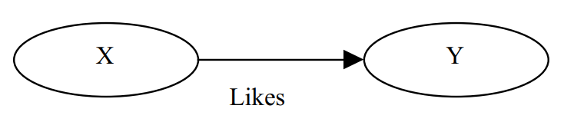
Semantic Network
Way of representing relationships between objects and ideas.
Consist fact in Binary(or n-ary) predicate: entity – predicate – entity
Entity (Network nodes): any objects such as people, location, event
Predicate (Network edge): relationship type between the two entity, such as likes, friend_of, lives_in, is_a, part_of
Exampe: Likes (X, Y)

Slide 24
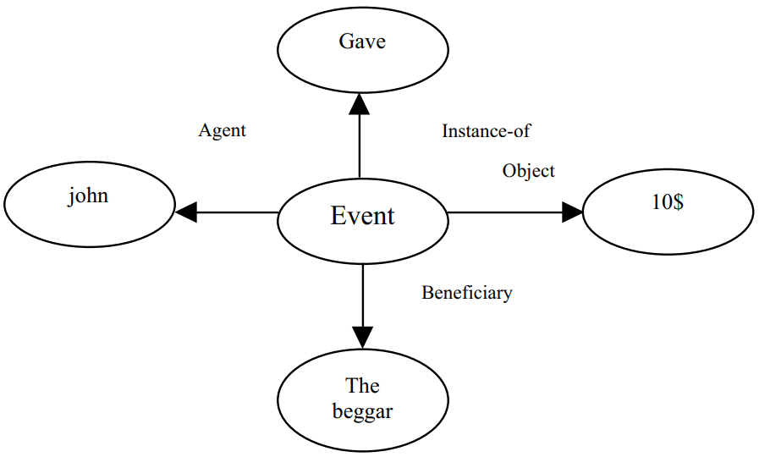
Semantic Network
Ternary predicate:
Gave(john, the-beggar, 10$)
Represented as collection of 4 Binary predicates given
Agent (john, event)
Beneficiary (the-beggar, event)
Object (10$, event)
Instance-of (give, event)

Slide 25
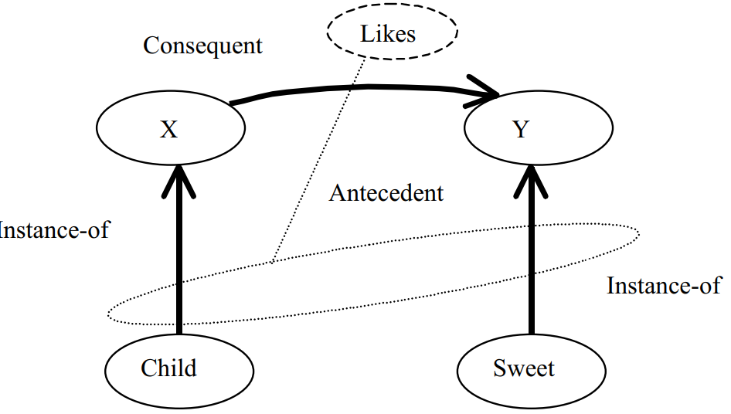
Semantic Network
Capability of representation of quantifiers
∀X ∃Y (Child (X) ∧ Sweet(Y) ⇒ Likes(X,Y))
Represented in Binary Predicate
∀X ∃Y (Instance-of (X, child) ∧ Instance-of (Y, sweet) ⇒ Likes (X, Y))

Slide 26
Inheritance in Semantic Network
A binary relation x < y is a partial order
when x < y and y < z holds good
If the concept in a semantic net has a partial order, we call the network an inheritance system.
While drawing the network, we, however, always omit the edge representing transitive inheritance.
if there is a directed edge from node u → v and v → w, the edge u → w is obvious and thus omitted.

Slide 27
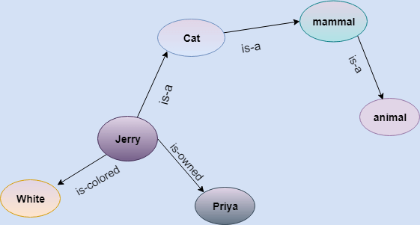
Semantic Network
Represent knowledge in the form of graphical networks.
Nodes representing objects
Arcs describe the relationship between those objects.
It categorizes the object in different forms and links those objects.
This representation consist of two types of relations:
IS-A relation (Inheritance)
Kind-of-relation
Jerry is a cat.
Jerry is a mammal
Jerry is owned by Priya.
Jerry is brown colored.
All Mammals are animal.

Slide 28
Semantic Nets
Origin:
Understanding natural language
The semantics (meaning) of the associated words in a sentence was extracted by employing such nets.
Wider application in reasoning of KB systems
WordNet:
large lexical database of English.
Nouns, verbs, adjectives and adverbs are grouped into sets of cognitive synonyms (synsets), each expressing a distinct concept.
To help computers understand the connections between different words in the English language

Slide 29
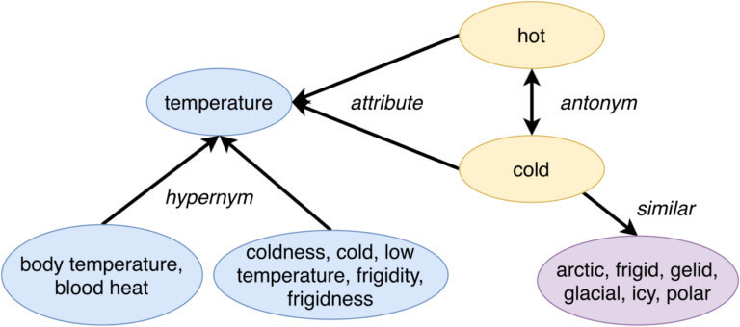
Application of Semantic Network
WordNet:
large lexical database of English.
Nouns, verbs, adjectives and adverbs are grouped into sets of cognitive synonyms (synsets), each expressing a distinct concept.
To help computers understand the connections between different words in the English language

Slide 30
Application of Semantic Network
SciCrunch:
collaboratively edited knowledge base about scientific resources.
provide a common source of data to the research community and the data about Research Resource Identifiers (RRIDs)
Knowledge Graph:
knowledge base that uses a graph-structured data model or topology to integrate data.
Store interlinked descriptions of entities
Google Knowledge Graph
WikiData
DBPedia

Slide 31
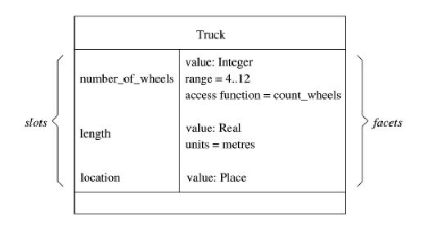
Frame Representation
A frame is a record like structure.
Consists of a collection of attributes and values to describe an entity in the world.
It consists of a collection of slots and slot values of any type and size.
Slots have names and values which are called facets.

Slide 32
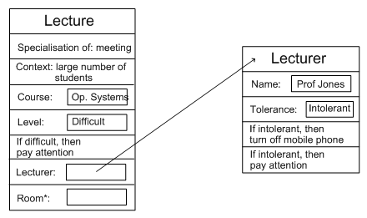
Frame Representations
Semantic networks where nodes have structure
Frame with a number of slots (age, height, ...)
Each slot stores specific item of information
When agent faces a new situation
Slots can be filled in (value may be another frame)
Filling in may trigger actions
May trigger retrieval of other frames
Inheritance of properties between frames
Very similar to objects in OOP

Slide 33
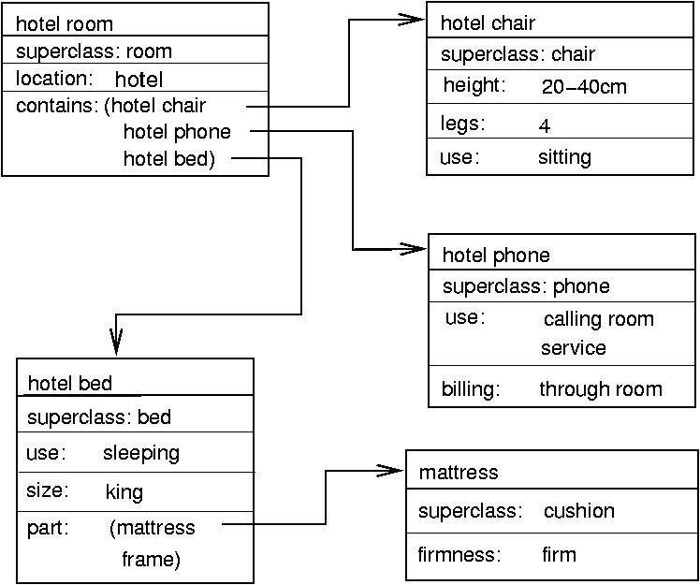
Example: Frame Representation

Slide 34
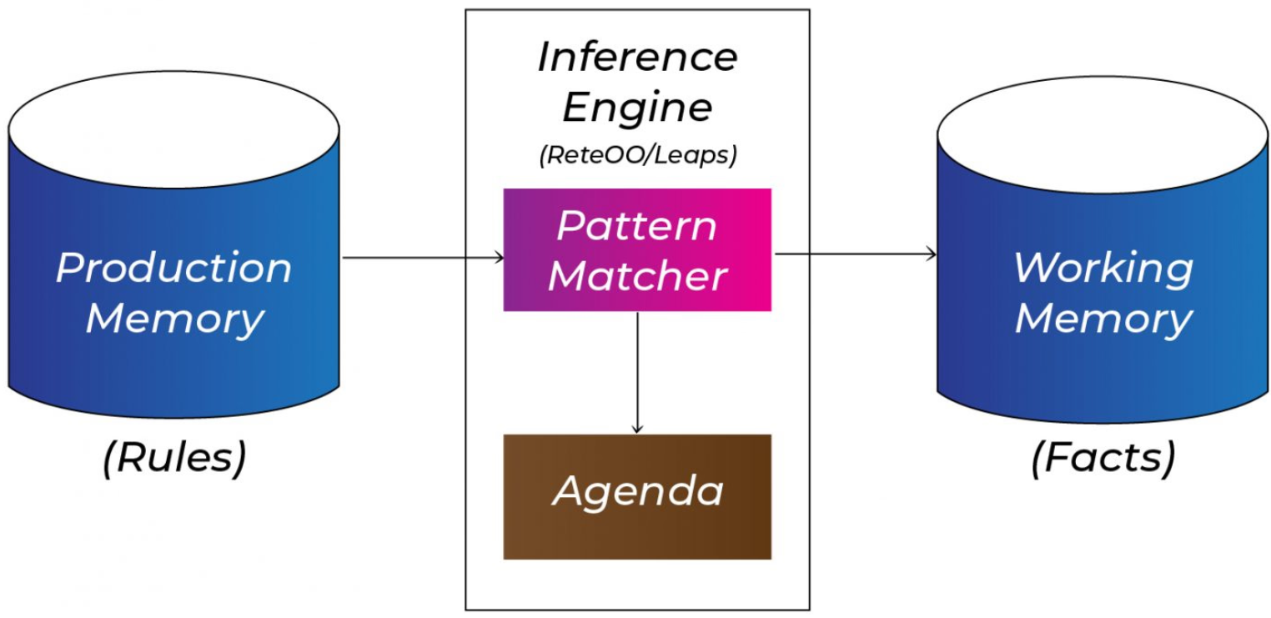
Production Base System
Agent checks for the condition and if the condition exists then production rule fires and corresponding action is carried out.
The condition part of the rule determines which rule may be applied to a problem.
The action part carries out the associated problem-solving steps.
This complete process is called a recognize-act cycle.
The production rules system consists of three main parts:
The set of production rules
Working Memory
The recognize-act-cycle
IF (at bus stop AND bus arrives) THEN action (get into the bus)
IF (on the bus AND paid AND empty seat) THEN action (sit down).
IF (on bus AND unpaid) THEN action (pay charges).
IF (bus arrives at destination) THEN action (get down from the bus).

Slide 35
Other Representation
Control Dependency
Script

Slide 36
Conceptual Dependency (CD)
CD theory was developed by Schank in 1973 to 1975 to represent the meaning of NL sentences.
It helps in drawing inferences
It is independent of the language
CD representation of a sentence built using conceptual primitives which give the intended meanings of words.
CD provides structures and specific set of primitives from which representation can be built.
“I gave the man a book.”
Where the symbols have the following meanings:
Arrows indicate direction of dependency.
Double arrow indicates two way link between actor and action.
p indicates past tense.
ATRANS is one of the primitive acts used by the theory. It indicates transfer of possession.
o indicates the object case relation.
R indicates the recipient case relation.
Notes:
<number>

Slide 37
Primitive Acts of CD theory
ATRANS Transfer of an abstract relationship (i.e. give)
PTRANS Transfer of the physical location of an object (e.g., go)
PROPEL Application of physical force to an object (e.g. push)
MOVE Movement of a body part by its owner (e.g. kick)
GRASP Grasping of an object by an action (e.g. throw)
INGEST Ingesting of an object by an animal (e.g. eat)
EXPEL Expulsion of something from the body of an animal (e.g. cry)
MTRANS Transfer of mental information (e.g. tell)
MBUILD Building new information out of old (e.g decide)
SPEAK Producing of sounds (e.g. say)
ATTEND Focusing of a sense organ toward a stimulus (e.g. listen)

Slide 38
Conceptual category
There are four conceptual categories
ACT Actions {one of the CD primitives}
PP Objects {picture producers}
AA Modifiers of actions {action aiders}
PA Modifiers of PP’s {picture aiders}
Conceptual Tenses
Notes:
<number>

Slide 39
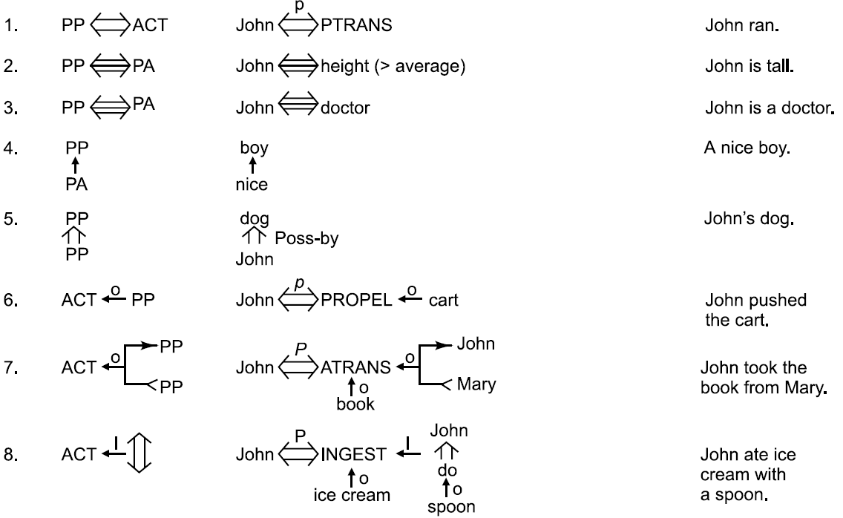
The Dependencies of CD

Slide 40
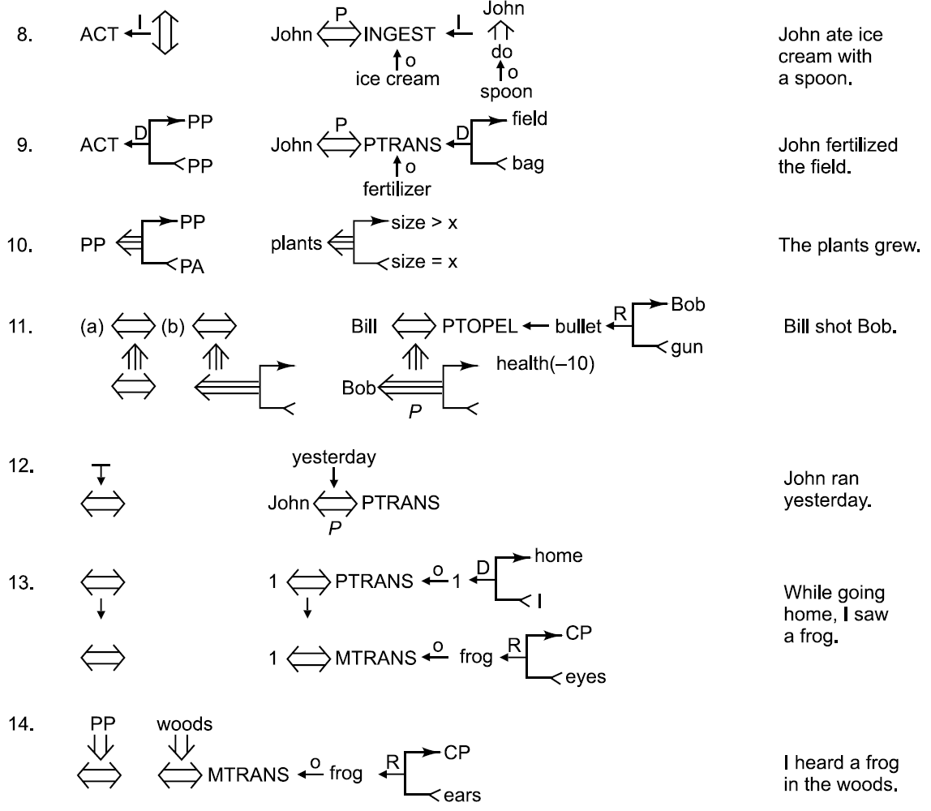
The Dependencies of CD

Slide 41
Generation of CD representations

Slide 43
Problems with CD Representation
It is difficult to
construct original sentence from its corresponding CD representation.
CD representation can be used as a general model for knowledge representation, because this theory is based on representation of events as well as all the information related to events.
Rules are to be carefully designed for each primitive action in order to obtain semantically correct interpretation.
Many verbs may fall under different primitive ACTs, and it becomes difficult to find correct primitive in the given context.
The CD representation becomes complex requiring lot of storage for many simple actions.
For example, the sentence “John bet Mike that Indian cricket team will win incoming world cup” will require huge CD structure.
Notes:
<number>

Slide 44
Script Structure
Scripts were introduced by Schank and Abelson introduced in 1977 that used CD framework.
The scripts are useful in describing certain stereotyped situations such as going to theater
It consists of set of slots containing default values along with some information about the type of values similar to frames.
It differs from FS as the values of the slots in scripts must be ordered and have more specialized roles.
In real world situations, we see that event tends to occur in known patterns because of clausal relationship to the occurrence of events

Slide 45
The Component of a Script
Entry conditions: Conditions that must, in general, be satisfied before the events described in the script can occur.
Result: Conditions that will, in general, be true after the events described in the script have occurred.
Props: Slots representing objects that are involved in the event described in the script.
Roles: Slots representing people who are involved in the events described in the script.
Track: The specific variation on a more general pattern that is represented by the particular script.
Scenes: The actual sequences of events that occur.

Slide 47
Script Invocation
It must be activated based on its significance.
If the topic is important, then the script should be opened.
If a topic is just mentioned, then a pointer to that script could be held.
For example, given “John enjoyed the play in theater”, a script “Play in Theater” suggested above is invoked.
All implicit questions can be answered correctly.
Here the significance of this script is high.
Did john go to theater?
Did he buy ticket?
Did he have money?
If we have a sentence like “John went to theater to pick his daughter”, then invoking this script will lead to many wrong answers.
Here significance of the script theater is less.
Getting significance from the story is not straightforward. However, some heuristics can be applied to get the value.

Slide 48
Advantages / Disadvantages of Script
Advantages
Capable of predicting implicit events
Single coherent interpretation may be build up from a collection of observations.
Disadvantage
More specific (inflexible) and less general than frames.
Not suitable to represent all kinds of knowledge.
To deal with inflexibility, smaller modules called memory organization packets (MOP) can be combined in a way that is appropriate for the situation.

Slide 49
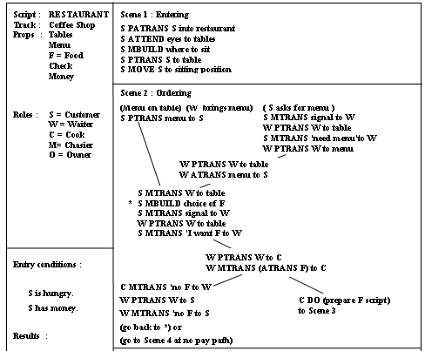
The Restaurant Script

Slide 50
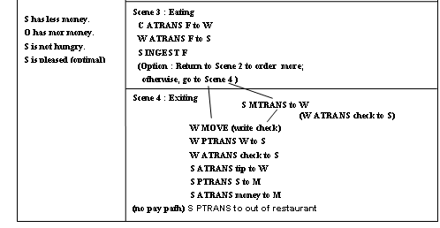
The Restaurant Script

Slide 51
Triggering and Using Scripts
Susan passed her favorite restaurant on her way to the museum. She really enjoyed the new Picasso exhibit.
John went out to a restaurant last night. He ordered steak. When he paid for it, he noticed that he was running out of money. He hurried home since it had started to rain.

Slide 52
Triggering and Using Scripts
Susan went out to lunch. She sat down at a table and called the waitress. The waitress brought her a menu and she ordered a hamburger.
John went to a restaurant. He was shown to his table. He ordered a large steak. He sat there and waited for a long time. He got mad and left.

